Slide 1
Greedy Algorithms
Lecture 11

Slide 2
Optimization Problems
Optimization Problem
Problem with an objective function to either:
Maximize some profit
Minimize some cost
Optimization problems appear in so many applications
Maximize the number of jobs using a resource [Activity-Selection Problem]
Encode the data in a file to minimize its size [Huffman Encoding Problem]
Collect the maximum value of goods that fit in a given bucket [knapsack Problem]
Select the smallest-weight of edges to connect all nodes in a graph [Minimum Spanning Tree]

Slide 3
Solving Optimization Problems
Two techniques for solving optimization problems:
Greedy Algorithms (“Greedy Strategy”)
Dynamic Programming
Space of optimization problems
Greedy algorithms can solve some problems optimally
Dynamic programming can solve more problems optimally (superset)
We still care about Greedy Algorithms because for some problems:
Dynamic programming is overkill (slow)
Greedy algorithm is simpler and more efficient

Slide 4
Greedy Algorithms
Main Concept
Divide the problem into multiple steps (sub-problems)
For each step take the best choice at the current moment (Local optimal) (Greedy choice)
A greedy algorithm always makes the choice that looks best at the moment
The hope: A locally optimal choice will lead to a globally optimal solution
For some problems, it works. For others, it does not

Slide 5
Greedy Algorithms
A greedy algorithm always makes the choice that looks best at the moment
The hope: a locally optimal choice will lead to a globally optimal solution
For some problems, it works
Dynamic programming can be overkill (slow); greedy algorithms tend to be easier to code
Activity-Selection Problem
Huffman Codes

Slide 6
The Greedy Method Technique
The greedy method is a general algorithm design paradigm, built on the following elements:
configurations: different choices, collections, or values to find
objective function: a score assigned to configurations, which we want to either maximize or minimize
It works best when applied to problems with the greedy-choice property:
a globally-optimal solution can always be found by a series of local improvements from a starting configuration.

Slide 7
Elements Of Greedy Algorithms
Greedy-Choice Property
At each step, we do a greedy (local optimal) choice
Top-Down Solution
The greedy choice is usually done independent of the sub-problems
Usually done “before” solving the sub-problem
Optimal Substructure
The global optimal solution can be composed from the local optimal of the sub-problems

Slide 8
Activity-Selection Problem
Problem: get your money’s worth out of a carnival
Buy a wristband that lets you onto any ride
Lots of rides, each starting and ending at different times
Your goal: ride as many rides as possible
Another, alternative goal that we don’t solve here: maximize time spent on rides
Welcome to the activity selection problem

Slide 9
Activity-Selection
Formally:
Given a set S of n activities S = {a₁, …, a_{n}}
s_{i} = start time of activity i
f_{i} = finish time of activity i
Find max-size subset A of compatible (non-overlapping ) activities
3
4
6
2
1
5
Assume that f₁ ≤ f₂ ≤ … ≤ f_{n}

Slide 10
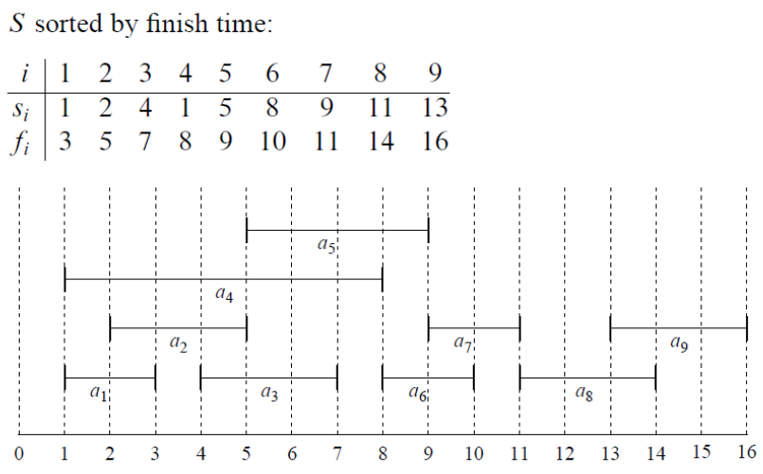
Example
Maximum-size mutually compatible set: {a₁, a₃, a₆, a₈}.
Not unique: also {a₂, a₅, a₇, a₉}.

Slide 11
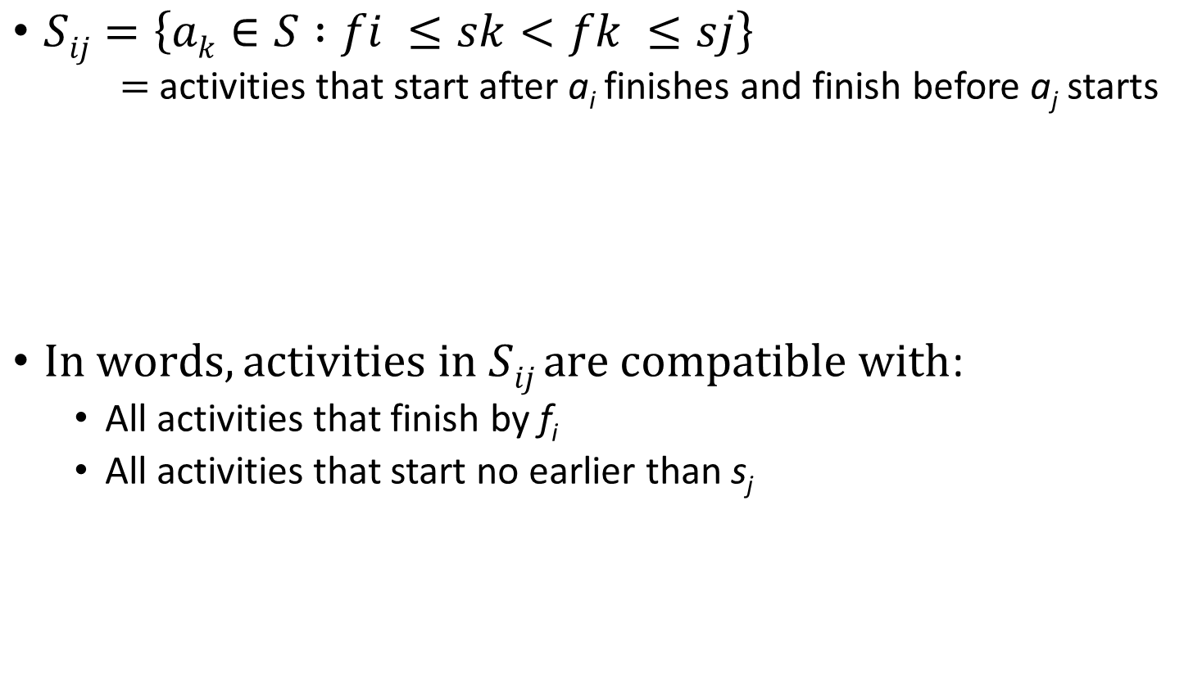
Activity Selection: Optimal Substructure
$Sij=\left\{ak∈S :fi ≤sk<fk ≤sj\right\}$
$=$ activities that start after a_{i} finishes and finish before a_{j} starts
$In words, activities in Sij are compatible with$:
All activities that finish by f_{i}
All activities that start no earlier than s_{j}

Slide 12
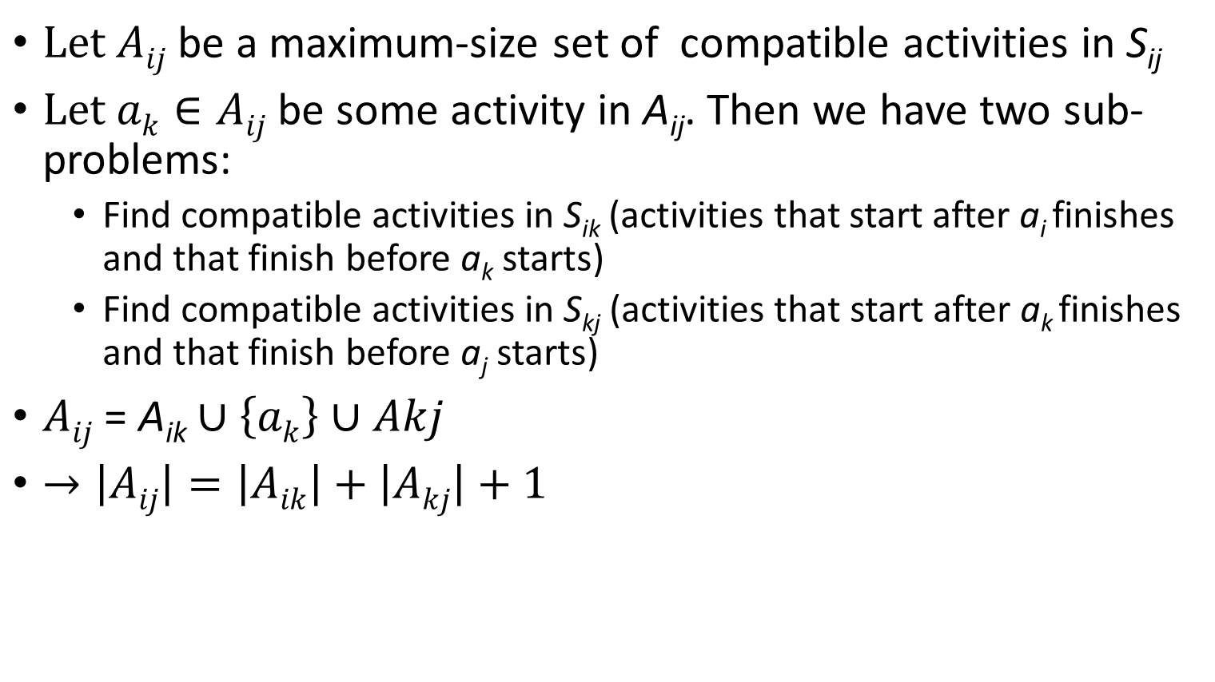
Activity Selection: Optimal Substructure
$Let Aij$ be a maximum-size set of compatible activities in S_{ij}
$Let$ $ak∈Aij$be some activity in A_{ij}. Then we have two sub-problems:
Find compatible activities in S_{ik} (activities that start after a_{i} finishes and that finish before a_{k} starts)
Find compatible activities in S_{kj} (activities that start after a_{k} finishes and that finish before a_{j} starts)
$Aij$ = A_{ik} $∪\left\{ak\right\}∪Akj$
$→\left|Aij\right|=\left|Aik\right|+\left|Akj\right|+1$

Slide 13

Activity Selection: Dynamic Programming
$Let c[i,j]$ be the size of optimal solution for S_{ij} $. Then,$
c[i,j] = c[i,k] + c[k,j] + 1

Slide 14
Greedy Choice Property
Dynamic programming
Solve all the sub-problems
Activity selection problem also exhibits the greedy choice property:
We should choose an activity that leaves the resource available for as many other activities as possible
The first greedy choice is a_{1,} since f₁ ≤ f₂ ≤ … ≤ f_{n}

Slide 15
Activity Selection: A Greedy Algorithm
So actual algorithm is simple:
Sort the activities by finish time
Schedule the first activity
Then schedule the next activity in sorted list which starts after previous activity finishes
Repeat until no more activities
Intuition is even more simple:
Always pick the shortest ride available at the time

Slide 16
Activity Selection: A Greedy Algorithm
Greedy Choice: Select the next best activity
(Local Optimal)
Select the activity that ends first (smallest end time)
Intuition: it leaves the largest possible empty space for more activities
Once selected an activity
Delete all non-compatible activities
They cannot be selected
Repeat the algorithm for the remaining activities
Either using iterations or recursion
Sub-problem: We created one sub-problem to solve
(Find the optimal schedule after the selected activity)
Hopefully when we merge the local optimal + the sub-problem optimal solution ➔ we get a global optimal

Slide 17
Greedy Algorithm Correctness
Theorem:
If S_{k} (activities that start after a_{k} finishes) is nonempty and a_{m} has the earliest finish time in S_{k}, then a_{m} is included in some optimal solution.
How to prove it?
We can convert any other optimal solution (S’) to the greedy algorithm solution (S)
Idea:
Compare the activities in S’ and S from left-to-right
If they match in the selected activity ➔ skip
If they do not match, we can replace the activity in S’ by that in S because the one in S finishes first

Slide 18
Example
We mapped S’ to S and showed that S is even better
S: {a₁, a₃, a₆, a₈}.
S’:{a₂, a₅, a₇, a₉}.
a₂, a₅, a₇, a₉ in S’ can be replaced by a₁, a₃, a₆, a₈ from S (finishes earlier)

Slide 19
Recursive Solution
Two arrays containing the start and end times
(Assumption: they are sorted based on end times)
The activity chosen in the last call
The problem size
Recursive-Activity-Selection(s, f, k, n)
m = k +1
While (m <= n) && ( s[m] < f[k])
m++;
If (m <= n)
return {A_{m}} U Recursive-Activity-Selection(s, f, m, n)
Else
return Φ
Find the next activity starting after the end of k
Time Complexity: O(n)
(Assuming arrays are already sorted, otherwise we add O(n Log n)

Slide 20
Iterative Solution
Two arrays containing the start and end times
(Assumption: they are sorted based on end times)
Iterative-Activity-Selection(s, f)
n = s.length
A = {a₁}
k = 1
for (m = 2 to n)
if (S[m] >= f[k])
A = A U {a_{m}}
k = m
Return A

Slide 21
Elements Of Greedy Algorithms
Proving a greedy solution is optimal
Remember: Not all problems have optimal greedy solution
If it does, you need to prove it
Usually the proof includes mapping or converting any other optimal solution to the greedy solution

Slide 22
Review: The Knapsack Problem
0-1 knapsack problem:
The thief must choose among n items, where the ith item worth v_{i} dollars and weighs w_{i} pounds
Carrying at most W pounds, maximize value
Note: assume v_{i}, w_{i}, and W are all integers
“0-1” b/c each item must be taken or left in entirety
A variation, the fractional knapsack problem:
Thief can take fractions of items
Think of items in 0-1 problem as gold ingots, in fractional problem as buckets of gold dust

Slide 23
Review: The Knapsack Problem And Optimal Substructure
Both variations exhibit optimal substructure
To show this for the 0-1 problem, consider the most valuable load weighing at most W pounds
If we remove item j from the load, what do we know about the remaining load?
A: remainder must be the most valuable load weighing at most W - w_{j} that thief could take from museum, excluding item j

Slide 24
Solving The Knapsack Problem
The optimal solution to the 0-1 problem cannot be found with the same greedy strategy
Greedy strategy: take in order of dollars/pound
Example: 3 items weighing 10, 20, and 30 pounds, knapsack can hold 50 pounds
Suppose 3 items are worth $60, $100, and $120.
Will greedy strategy work?

Slide 25
Fractional knapsack problem
The setup is same, but the thief can take fractions of items, meaning that the items can be broken into smaller pieces so that thief may decide to carry only a fraction of x_{i} of item i, where 0 ≤ x_{i} ≤ 1.Exhibit greedy choice property.
Greedy algorithm exists.
Exhibit optimal substructure property.
?????

Slide 26
Greedy Solution - Fractional Knapsack Problem
There are n items in a store. For i =1,2, . . . , n, item i has weight w_{i} > 0 and worth v_{i}> 0. Thief can carry a maximum weight of W pounds in a knapsack.
In this version of a problem the items can be broken into smaller piece, so the thief may decide to carry only a fraction x_{i} of object i, where 0 ≤ x_{i} ≤
Item i contributes x_{i}w_{i} to the total weight in the knapsack, and x_{i}v_{i} to
the value of the load.
In Symbol, the fraction knapsack problem can be stated as follows. maximize ^{n}S_{i=1} x_{i}v_{i} subject to constraint ^{n}S_{i=1} x_{i}w_{i} ≤ W
It is clear that an optimal solution must fill the knapsack exactly, for otherwise we could add a fraction of one of the remaining objects and increase the value of the load. Thus in an optimal solution ^{n}S_{i=1} x_{i}w_{i} = W.

Slide 27
The knapsack problem
n objects, each with a weight w_{i} > 0
a profit V_{i} > 0 capacity of knapsack:W
∑ V_{i} x_{i}
1≤i≤n
∑ w_{i} x_{i} ≤ W
1≤i≤n
Maximize
Subject to
0 ≤ x_{i} ≤ 1, 1 ≤ i ≤ n

Slide 28
The knapsack Pseudo Code
The greedy algorithm:
Step 1: Sort p_{i}/w_{i} into nonincreasing order.
Step 2: Put the objects into the knapsack according
to the sorted sequence as possible as we can.

Slide 29
Algorithm
Greedy-fractional-knapsack (w, v, W)
FOR i =1 to do
x[i] =0
weight = 0
while weight < W do
i = best remaining item
IF weight + w[i] ≤ W then
x[i] = 1
weight = weight + w[i] else
x[i] = (w - weight) / w[i] weight = W
return x

Slide 30
Knapsack Problem
Objects(O) | 1 | 2 | 3 | 4 | 5 | 6 | 7
Profits (P) | 10 | 5 | 15 | 7 | 6 | 18 | 3
Weight (W) | 2 | 3 | 5 | 7 | 1 | 4 | 1
15 KG

Slide 31
Knapsack Problem
Objects(O) | 1 | 2 | 3 | 4 | 5 | 6 | 7
Profits (P) | 10 | 5 | 15 | 7 | 6 | 18 | 3
Weight (W) | 2 | 3 | 5 | 7 | 1 | 4 | 1
X | X₁ | X₂ | X₃ | X₄ | X₅ | X₆ | X₇
15 KG

Slide 32
Knapsack Problem
Objects(O) | 1 | 2 | 3 | 4 | 5 | 6 | 7
Profits (P) | 10 | 5 | 15 | 7 | 6 | 18 | 3
Weight (W) | 2 | 3 | 5 | 7 | 1 | 4 | 1
P/W | 5 | 1.3 | 3 | 1 | 6 | 4.5 | 3
X | X₁ | X₂ | X₃ | X₄ | X₅ | X₆ | X₇
15 KG

Slide 33
Knapsack Problem
Objects(O) | 1 | 2 | 3 | 4 | 5 | 6 | 7
Profits (P) | 10 | 5 | 15 | 7 | 6 | 18 | 3
Weight (W) | 2 | 3 | 5 | 7 | 1 | 4 | 1
P/W | 5 | 1.3 | 3 | 1 | 6 | 4.5 | 3
X | X₁ | X₂ | X₃ | X₄ | X₅ | X₆ | X₇
15 – 1 = 14
15 KG

Slide 34
Knapsack Problem
Objects(O) | 1 | 2 | 3 | 4 | 5 | 6 | 7
Profits (P) | 10 | 5 | 15 | 7 | 6 | 18 | 3
Weight (W) | 2 | 3 | 5 | 7 | 1 | 4 | 1
P/W | 5 | 1.3 | 3 | 1 | 6 | 4.5 | 3
X | X₁ | X₂ | X₃ | X₄ | X₅ | X₆ | X₇
15 – 1 = 14
14 – 2 = 12
15 KG

Slide 35
Knapsack Problem
Objects(O) | 1 | 2 | 3 | 4 | 5 | 6 | 7
Profits (P) | 10 | 5 | 15 | 7 | 6 | 18 | 3
Weight (W) | 2 | 3 | 5 | 7 | 1 | 4 | 1
P/W | 5 | 1.3 | 3 | 1 | 6 | 4.5 | 3
X | X₁ | X₂ | X₃ | X₄ | X₅ | X₆ | X₇
15 – 1 = 14
14 – 2 = 12
12 – 4 = 8
15 KG

Slide 36
Knapsack Problem
Objects(O) | 1 | 2 | 3 | 4 | 5 | 6 | 7
Profits (P) | 10 | 5 | 15 | 7 | 6 | 18 | 3
Weight (W) | 2 | 3 | 5 | 7 | 1 | 4 | 1
P/W | 5 | 1.3 | 3 | 1 | 6 | 4.5 | 3
X | X₁ | X₂ | X₃ | X₄ | X₅ | X₆ | X₇
15 – 1 = 14
14 – 2 = 12
12 – 4 = 8
8 – 5 = 3
15 KG

Slide 37
Knapsack Problem
Objects(O) | 1 | 2 | 3 | 4 | 5 | 6 | 7
Profits (P) | 10 | 5 | 15 | 7 | 6 | 18 | 3
Weight (W) | 2 | 3 | 5 | 7 | 1 | 4 | 1
P/W | 5 | 1.3 | 3 | 1 | 6 | 4.5 | 3
X | X₁ | X₂ | X₃ | X₄ | X₅ | X₆ | X₇
15 – 1 = 14
14 – 2 = 12
12 – 4 = 8
8 – 5 = 3
3 – 1 = 2
15 KG

Slide 38
Knapsack Problem
Objects(O) | 1 | 2 | 3 | 4 | 5 | 6 | 7
Profits (P) | 10 | 5 | 15 | 7 | 6 | 18 | 3
Weight (W) | 2 | 3 | 5 | 7 | 1 | 4 | 1
P/W | 5 | 1.3 | 3 | 1 | 6 | 4.5 | 3
2 /3
X | X₁ | X₂ | X₃ | X₄ | X₅ | X₆ | X₇
15 – 1 = 14
14 – 2 = 12
12 – 4 = 8
8 – 5 = 3
3 – 1 = 2
2 – 2 = 0
15 KG

Slide 39
Knapsack Problem
Objects(O) | 1 | 2 | 3 | 4 | 5 | 6 | 7
Profits (P) | 10 | 5 | 15 | 7 | 6 | 18 | 3
Weight (W) | 2 | 3 | 5 | 7 | 1 | 4 | 1
P/W | 5 | 1.3 | 3 | 1 | 6 | 4.5 | 3
2 /3
0
X | X₁ | X₂ | X₃ | X₄ | X₅ | X₆ | X₇
15 – 1 = 14
14 – 2 = 12
12 – 4 = 8
8 – 5 = 3
3 – 1 = 2
2 – 2 = 0
15 KG

Slide 40
Knapsack Problem
Objects(O) | 1 | 2 | 3 | 4 | 5 | 6 | 7
Profits (P) | 10 | 5 | 15 | 7 | 6 | 18 | 3
Weight (W) | 2 | 3 | 5 | 7 | 1 | 4 | 1
P/W | 5 | 1.3 | 3 | 1 | 6 | 4.5 | 3
2 /3
0
X | X₁ | X₂ | X₃ | X₄ | X₅ | X₆ | X₇
Calculate Weight
^{σ 𝑥}𝑖 𝑤_{𝑖}=
1 𝑥 2 + 2/3 𝑥 3 + 1 𝑥 5 + 0 𝑥 7 + 1 𝑥 1 + 1 𝑥 4 + 1 𝑥 1
2 + 2 + 5 + 0 + 1 + 4 + 1 = 15
Calculate Profit
2
෍ 𝑥_{𝑖 𝑝𝑖=} 1 𝑋 10 + _{3𝑥5} + 1𝑥15 + 1𝑥6 + 1𝑥18 + 1𝑥3
10 + 2𝑥1.3 + 15 + 6 + 18 + 3 = 54.6

Slide 41
Conclusion
Constraints
σ 𝑥_{𝑖 𝑤𝑖 ≤} m where m = 15
Objective
𝑀𝐴𝑋 ෍ 𝑥_{𝑖 𝑝𝑖=}

Slide 42
Analysis
If the items are already sorted into decreasing order of v_{i} / w_{i,} then the while-loop takes a time in O(n);
Therefore, the total time including the sort is in O(n log n).
If we keep the items in heap with largest v_{i}/w_{i} at the root. Then
creating the heap takes O(n) time
while-loop now takes O(log n) time (since heap property must be restored after the removal of root)
Although this data structure does not alter the worst-case, it may be faster if only a small number of items are need to fill the knapsack.

